Slide 1
Telecom Churn Case Study
Rakesh Verma
Sagar Prakash Kulkarni
Renu VIND

Slide 2
Agenda
Problem Statement
Methodology
EDA
Data Manipulation
Model Building
Final Model
Key Insight

Slide 3
Problem Statement
Business Objective
In the telecom Industry customers are able to choose from multiple service providers and activity switch from one operator to another. In this highly competitive market, the telecommunication industry experience an average of 15-25% annual churn rate.
Given the fact that it cost 5-10 times more to acquire a new customer than to retain an existing one, customer retention has now become even more important than customer acquisition.
For many incumbent operators, retaining high profitable customers is the number one business goal.
To reduce customer churn, telecom companies need to predict which customers are at high risk.
The dataset contains customers-level information for a span of four consecutive months –Jun, Jul, Aug and Sep. The months are encoded as 6, 7, 8 and 9 respectively.
The business objective is to predict the churn in the last (i.e. ninth month) using the data (features) from the first three months. To do this task well, understanding the typical customer behavior during churn will be helpful.

Slide 4
Methodology
Data Cleaning
Check and handle duplicate data.
Check and handle NA values and missing values.
Drop columns, if it contains large amount of missing values and not useful for the analysis.
Imputation of the values, if necessary.
Check and handle outliers in data.
Exploratory Data Analysis
Univariate data analysis: value count, distribution of variable etc.
Bivariate data analysis: correlation coefficients and pattern between the variables etc.
Data preparation, Standardization, Handling Class Imbalance, Principal Component Analysis(PCA)
Selecting the best classification model: Logistic regression, Decision Tree, Random Forest
Validation of the best model

Slide 5
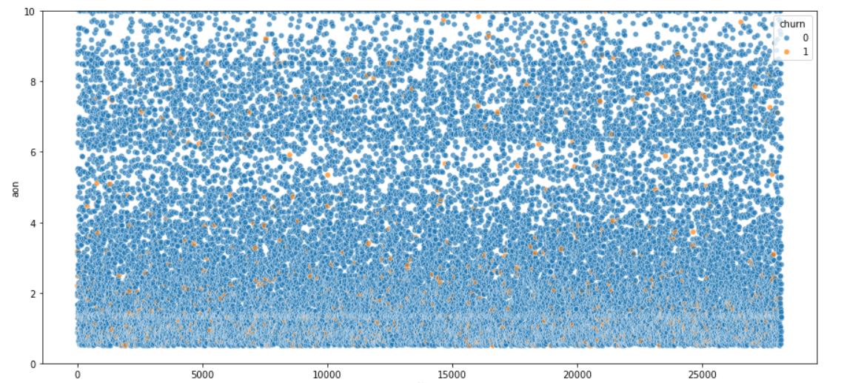
Univariate Analysis
We can see that users who had the max recharge amount less than 200 churned more

Slide 6
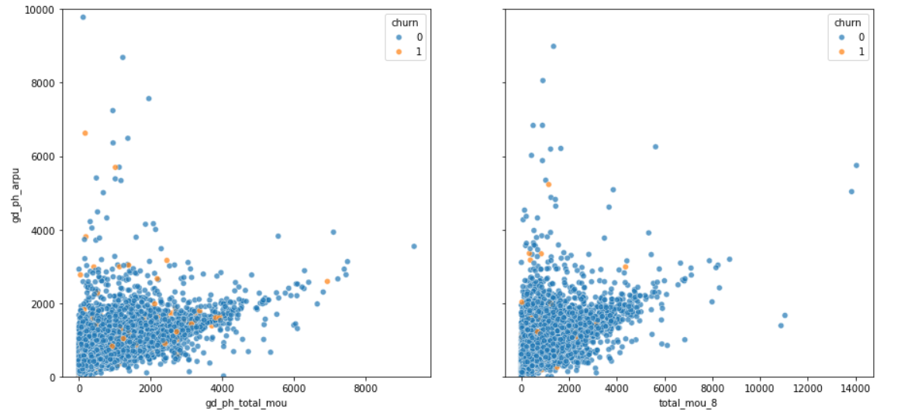
Multivariate Analysis
We can clearly see that MOU have dropped significantly for the churners in the action phase i.e. 8th month, thus hitting the revenue generated from them
It is also interesting that though the MOU is between 0-2000, the revenue is highest in that region that tells us these users had other services that were boosting the revenue

Slide 7
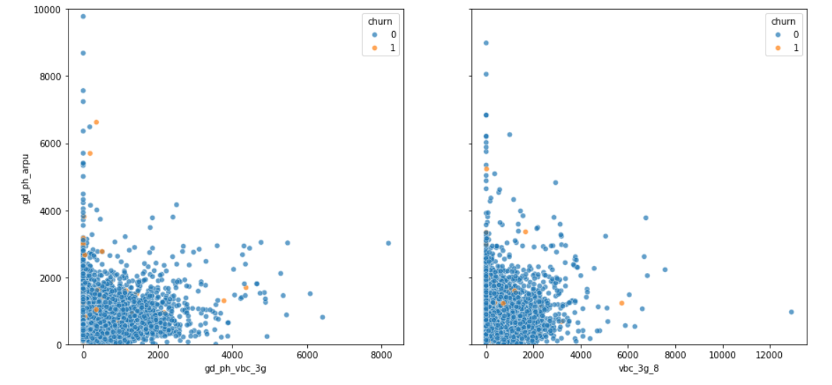
Multivariate Analysis Cont.
We can see that the users who were using very less amount of VBC data and yet were generating high revenue churned
Yet again we see that the revenue is higher towards the lesser consumption side

Slide 8
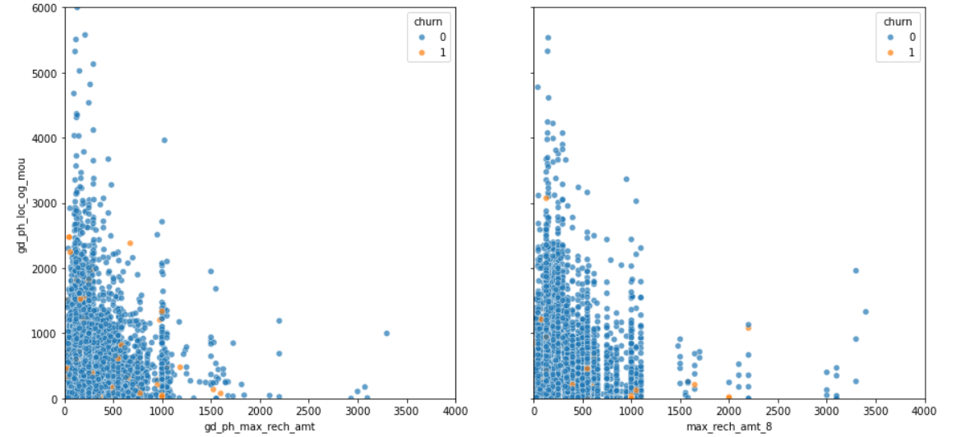
Multivariate Analysis Cont.
Users who were recharging with high amounts were using the service for local uses less as compared to user who did lesser amounts of recharge
Intuitively people whose max recharge amount as well as local out going were very less even in the good phase churned more

Slide 9
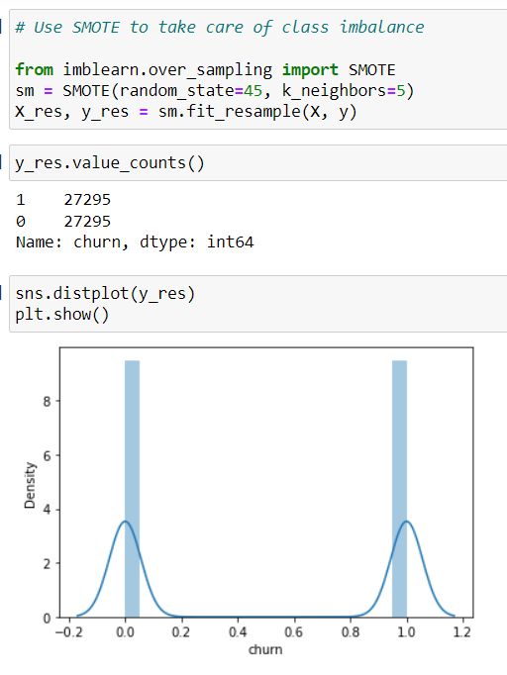
Handling Class Imbalance

Slide 10
Model Building
As the dependent variable is categorical hence the general model is a classification model.
Now classification taught are- Logistic Regression, Decision Tree and Random Forest.
Hence, all three models have been made and tested on various parameters and results like accuracy, precision, ROC.
After analyzing all, the three models, the best model came out to be Random Forest.

Slide 11
Interpretation
Given our business problem, to retain their customers, we need higher recall. As giving an offer to an user not going to churn will cost less as compared to loosing a customer and bring new customer, we need to have high rate of correctly identifying the true positives, hence recall.
When we compare the models trained we can see the tuned random forest is performing the best, which is highest accuracy along with highest recall i.e. 95%. So, we will go with random forest.

Slide 12
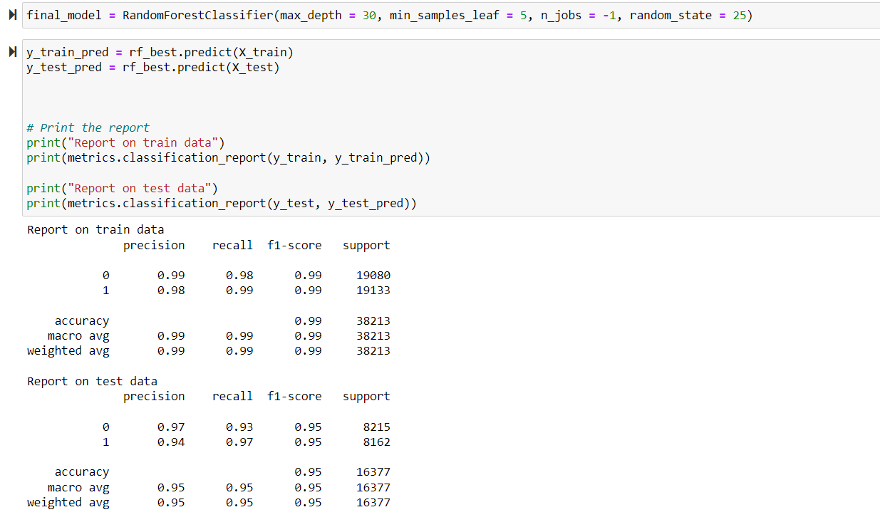
Final Model

Slide 13
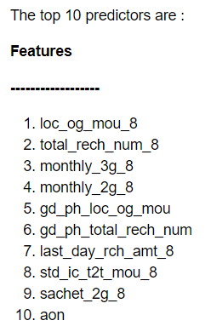
Key Insights
We can see most of the top predictors are from the action phase, as the drop in engagement is prominent in that phase
Some of the factors we noticed while performing EDA which can be clubbed with these insights are:
Users whose maximum recharge amount is less than 200 even in the good phase, should have a tag and re-evaluated time to time as they are more likely to churn
Users that have been with the network less than 4 years, should be monitored time to time, as from data we can see that users who have been associated with the network for less than 4 years tend to churn more
MOU is one of the major factors, but data especially VBC if the user is not using a data pack if another factor to look out

